Slide 1
Motion Part 4
Vector Measurements:
Velocity & Acceleration

Slide 2
Velocity
The speed and direction of an object’s motion.
88 km / hr southwest
Velocity is a speed in a specific direction
Velocity is an example of a vector
A vector is a quantity that has both magnitude and direction

Slide 3
What This Means
If you want to understand how an object (like a car, ball, person, or rocket) moves, you have to understand three things about what it means "to be moving." These three things "stick" to any object that moves, and are numbers that scientifically describe just how an object's motion is working. These three things are:
Position. This is precisely where an object is located.
Velocity. Precisely how fast an object is moving and in what direction
Acceleration. Precisely how fast an object's velocity is changing.

Slide 4
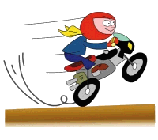
Acceleration
When a car moves faster and faster,
its speed is increasing (velocity changed).

Slide 5
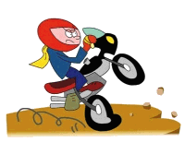
Acceleration
When a car moves slower and slower,
its speed is decreasing (velocity changed).

Slide 6
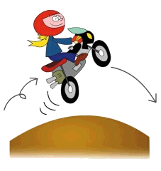
Acceleration
When a car changes direction,
its velocity changes too.

Slide 7
Acceleration
Acceleration measures the change in velocity
Acceleration = Δvelocity per unit time
overall change in velocity
v_{f} - v_{i}
=
=
total time taken
t
= m/s/s = m /s²
vector quantity

Slide 8
Example 1
If an object starts at 15 m/s and after 7 s is moving at 4 m/s, what is the object’s acceleration?
a= ?
v_{i}= 15 m/s
v_{f}= 4 m/s
t= 7 s
a = v_{f} – v_{i} /t
a = 4 – 15 /7
a = -11 /7
a = -1.57 m/s²

Slide 9
Example 2
An object has an acceleration of 4 m/s². If it’s initial velocity is 0 m/s and it moved for 13 s, what is it’s final velocity?
a= 4 m/s²
v_{f}= ?
v_{i}= 0 m/s
t= 13s
a = v_{f} – v_{i} /t
at = v_{f} – v_{i}
at + v_{i} = v_{f}
(4)(13) + 0 = v_{f}
52 m/s = v_{f}

Slide 10
Example 3
If an object starts at 20 m/s and has a final velocity of 0 m/s with an acceleration of -4 m/s², how much time will it take to stop?
a= -4 m/s²
v_{f}= 0 m/s
v_{i}= 20 m/s
t= ?
a = v_{f} – v_{i} /t
at = v_{f} – v_{i}
t = v_{f} – v_{i}/a
t = 0 – 20/-4
t = -20/-4
t = 5 s

