Slide 1
Friction
Unit 3: Forces – Part 5

Slide 2
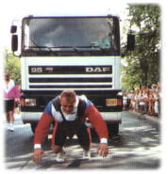
Friction
Friction is a Force that always pushes against an object when it touches another object.
When 2 things are in contact with each other, there will be friction acting between them.

Slide 3
Friction…
High friction (lots of friction) – will slow something down
Low friction (not much friction) – will keep things moving

Slide 4
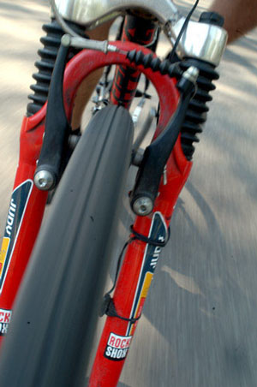
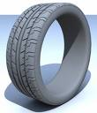
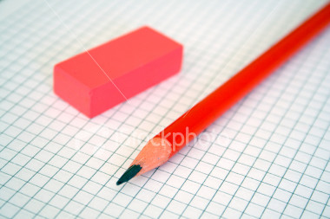
High friction or Low friction?
High
Ski’s on the snow
Car tire
Brakes on a bike
Water on a slide
Pencil and eraser
Low
High
High
Low

Slide 5
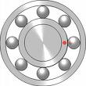
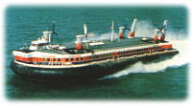
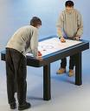
How can we reduce the friction between 2 objects?
Reduce the contact area by using rollers/ball-bearings/wheels
Change the surfaces of the materials that are touching by using lubrication eg. Oil
Create a cushion of air
Eg. Like a hovercraft or air hockey table

Slide 6
Types of friction
Static
Kinetic
Rolling
Fluid

Slide 7
Static
Friction that acts on something that is not moving
Piano is held in place by static friction
Static friction keeps you in your seat
No heat or wear is generated

Slide 8
Kinetic
Force resulting when pushing or pulling an object over a surface.
Moving day—pushing a box across the floor
Heat and wear can result

Slide 9
Rolling
Contact is reduced because of rollers or wheels or ball bearings.
Skate boards have ball bearings in the wheels.
A cart has wheels.
Less heat and wear will result.

Slide 10
Fluid friction
Resistance from a “liquid” or air.
Stirring a thick batter
Walking through water
Olympic bike riders

Slide 11
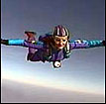
“Fluid” Friction
This type of friction is what happens with liquids and gases (In Physics, liquids and gases are both called "fluids". They behave in similar ways.)
Fluid friction is also known as "drag". On aircraft it's also called "air resistance". It depends on:-
how thick the fluid is (its "viscosity")
the shape of the object
the speed of the object

Slide 12
Mu
is the coefficient of friction.
Kinetic friction formula:
f_{k}=µ_{k}F_{N}
Static friction formula:
f_{s}=µ_{s}F_{N}
Generic Formula:
F_{f}=μF_{N}

Slide 13
Typical values of Mu:
Wood on wood .25-.5
Glass on glass .9-1.0
Steel on steel .6
Steel on steel with oil .09
Rubber on dry pavement 1.0
Ski on snow .04
Teflon on teflon .04

Slide 14
Practice Problem
What is the force due to friction for an object that has a Normal force of 25 N and is pushed along a surface with a friction coefficient of .42?
F_{f} = ?
μ = .42
F_{N} = 25 N
F_{f} = μF_{N}
F_{f} = (.42)(25)
F_{f} = 10.5 N

Slide 15
Practice Problem
What is the force due to friction for an object that has a mass of 15 kg and is pushed along a surface with a friction coefficient of .27?
W=F_{N}
m=15kg
g=9.8 m/s²
F_{f} = ?
μ = .27
F_{N} = ?
F_{f} = μF_{N}
W = mg
W = (15)(9.8)
F_{f} = (.27)(147)
W = 147 N
F_{f} = 39.69 N
F_{N} = 147 N

